Slide 1
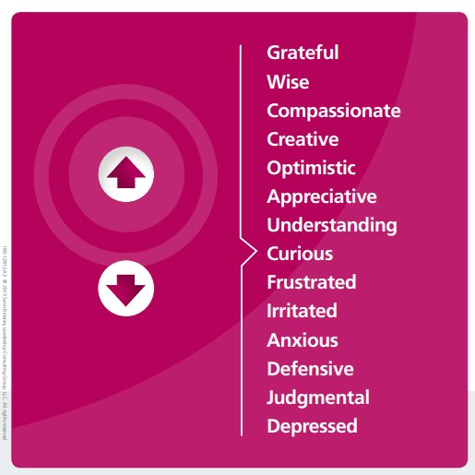
NAME
DEPT
OVERALL AND OPTUM EXPERIENCE
CURRENT ROLE
FUTURE ROLE (IF ANY CHANGE)
WHERE ARE YOU ON MOOD ELEVATOR?
30 SECONDS

